Slide 1
Introduction to GraphRAG
Prepared By:
Dr. Ronakkumar Panchal
IT Project Manager & Senior Data Scientist
Website: http://drronakpanchal.wordpress.com
Mar 2025

Slide 2
Outline
Introduction to GraphRAG
About RAG and How RAG works?
What is Graph, Graph Database and Knowledge Graph
Popular tools of KG
Key Importance of GraphRAG
GraphRAG Lifecycle and Architect
Why GraphRAG?
Constructing knowledge graphs
Domo – About GraphRAG

Slide 3
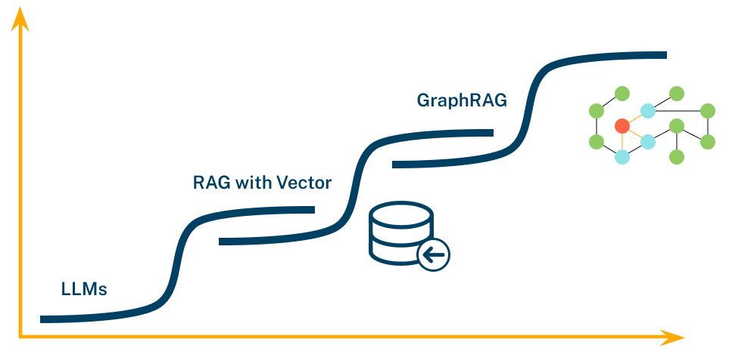
We’re Entering the “Blue Links” Era of RAG
What is RAG and Knowledge Graph??
Issues with baseline RAG
How GraphRAG works?
Advantages of GraphRAG over naïve RAG

Slide 4
What is a RAG?
RAG stands for Retrieval-Augmented Generation, which is a natural language processing (NLP) technique that combines generative and retrieval-based artificial intelligence (AI) models.
RAG is used to improve the output of large language models (LLMs) by providing more relevant, accurate, and up-to-date text.
It is a Framework that enables an LLM to understand the external context (passed as PDF, text file, videos, etc.) and use this private knowledge for doing tasks specific to you.
Source

Slide 5
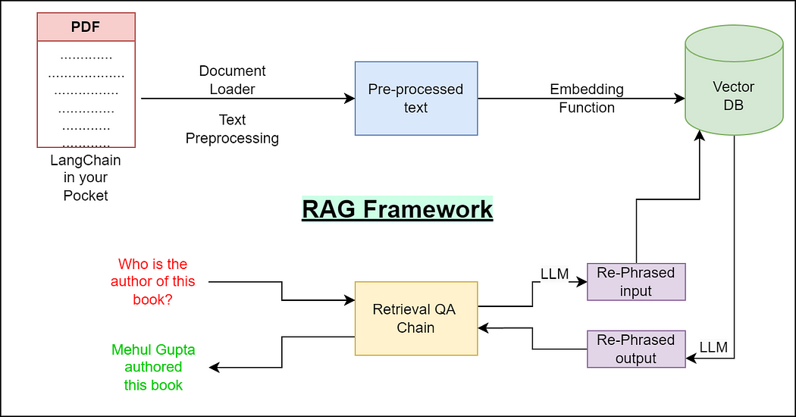
How RAG works?
The external document is fed to DocumentLoaders which extracts text out of any document type, be it PDF or a video.
Then some pre-processing steps are applied to this extracted text (similar to NLP).
Generate embeddings for this pre-processed text using any model (say BERT)
Store these texts alongside their respective embeddings in Vector DBs. Vector DBs are specialized databases that store embeddings and enable functionalities like text similarity search.
We will then initiate a RetrievalChain (which uses an LLM internally)
Source

Slide 6
What is a Graph, Graph Database & Knowledge Graph?
Graph’s mathematical term is G={V,E}
A graph is a pictorial representation of a set of objects where some pairs of objects are connected by links.
It is composed of two elements - nodes (vertices) and relationships (edges).
Graph database is a database used to model the data in the form of graph.
In here, the nodes of a graph depict the entities while the relationships depict the association of these nodes.
A knowledge graph is an organized representation of real-world entities and their relationships. It is typically stored in a graph database, which natively stores the relationships between data entities. Entities in a knowledge graph can represent objects, events, situations, or concepts.

Slide 7
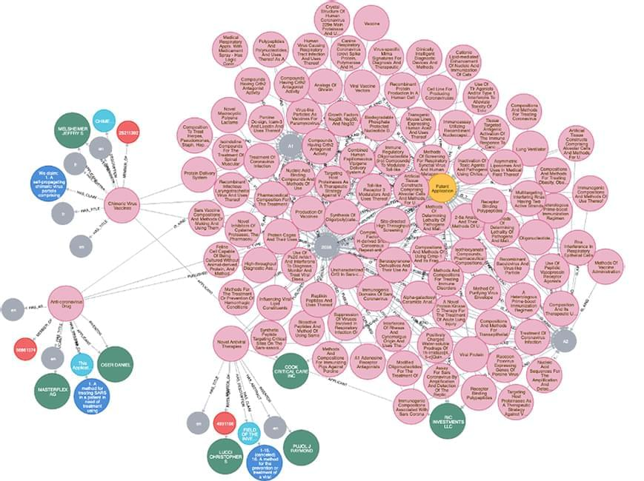
Introduction to Knowledge graph (KG)
A knowledge graph (KG) is a network of real-world entities and their relationships, which is used to organize data from multiple sources.
KGs can be used to:
Integrate data: KGs can link information from various sources, such as relational databases, spreadsheets, and text documents.
Add context: KGs can provide context and depth to AI techniques like machine learning.
Make data accessible: KGs can make information more accessible to all members of an organization.
Answer questions: KGs can link information from different sources to answer questions.
Source

Slide 8
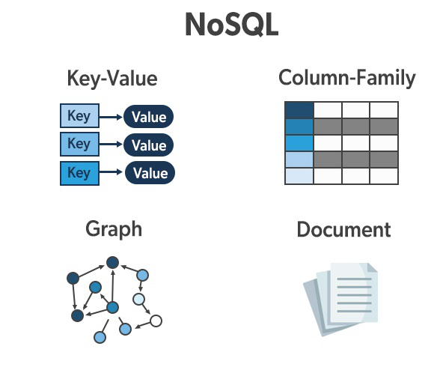
Graph Database Exist under NoSQL databases
Over time, four major types of NoSQL databases emerged:
Document databases store data in documents similar to JSON (JavaScript Object Notation) objects. Each document contains pairs of fields and values.
Key-value databases are a simpler type of database where each item contains keys and values.
Wide-column stores data in tables, rows, and dynamic columns.
Graph databases store data in nodes and edges. Nodes typically store information about people, places, and things, while edges store information about the relationships between the nodes.

Slide 9
Popular tools and platforms where you can store knowledge graphs
To develop GraphRAG (Graph-based Retrieval-Augmented Generation), you will need tools for creating, managing, and querying knowledge graphs. Knowledge graph storage systems typically allow you to organize entities and their relationships in a graph structure, which can be queried for relevant information during the retrieval step in GraphRAG.
Here is a list of some popular tools and platforms where you can store knowledge graphs:
Neo4j
Amazon Neptune
Microsoft Azure Cosmos DB
ArangoDB
GraphDB (by Ontotext)
AllegroGraph
Stardog
TigerGraph
Blazegraph (formerly Bigdata)
Cayley
Virtuoso
RedisGraph
SPARQL Endpoint Solutions
Datastax Graph (Apache Cassandra + Graph)
Oracel Spatial and Graph
GraphX (Apache Spark)
JanusGraph
GraphStore
SonicDB
Oxygen Graph
Memgraph
FlockDB
SAP Graph
RDFLib (Python library)
Dgraph
Linked Data Platform (LDP)
TinkerPop (Apache)
Cassandra (with Graph extensions)
Lucene / Elasticsearch with Graph Capabilities
RedisGraph (Module for Redis)
MarkLogic
Kgraph
Wikidata Query service(SPARQL)
QLever

Slide 10
Introduction to GraphRAG
GraphRAG is a structured, hierarchical approach to Retrieval Augmented Generation (RAG), as opposed to naive semantic-search approaches using plain text snippets. The GraphRAG process involves extracting a knowledge graph out of raw text, building a community hierarchy, generating summaries for these communities, and then leveraging these structures when perform RAG-based tasks.
Retrieval-Augmented Generation (RAG) is a technique to improve LLM outputs using real-world information. This technique is an important part of most LLM-based tools and the majority of RAG approaches use vector similarity as the search technique.
GraphRAG uses knowledge graphs to provide substantial improvements in question-and-answer performance when reasoning about complex information. RAG techniques have shown promise in helping LLMs to reason about private datasets - data that the LLM is not trained on and has never seen before, such as an enterprise’s proprietary research, business documents, or communications.
Source

Slide 11
Key Importance of GraphRAG
GraphRAG and Retrieval Augmented Generation (RAG) are both techniques that use external knowledge sources to improve the outputs of Large Language Models (LLMs). However, GraphRAG is an evolution of RAG that uses knowledge graphs to provide more accurate and comprehensive answers to complex questions:
Information retrieval: GraphRAG uses knowledge graphs to extract entities, relationships, and concepts from data, while RAG uses vector stores to retrieve documents.
Answer generation: GraphRAG combines the extracted entities, relationships, and concepts with the query to generate a response, while RAG combines the top documents with the query to generate a response.
Answer quality: GraphRAG provides more accurate and comprehensive answers because it understands how different pieces of data relate. RAG can struggle to connect the dots and provide holistic understanding of large data collections.
Query handling: GraphRAG excels at handling nuanced queries, such as asking about the relationships between characters in a story.
Source

Slide 12
Why GraphRAG?
The benefits we are seeing from GraphRAG relative to vector-only RAG fall into three main buckets:
Higher accuracy and more complete answers (runtime / production benefit)
Once you’ve created your knowledge graph, then it’s easier to both build and subsequently maintain your RAG application (development time benefit)
Better explainability, traceability, and access controls (governance benefit)
Source

Slide 13
Advantages of GraphRAG over Traditional RAG
Traditional RAG relies on vector search, which retrieves conceptually similar text chunks using statistical similarity.
Vectors encode meaning as numerical arrays but lack transparency and contextual understanding.
They are useful for matching text but not for explaining or reasoning about the content. Traditional vector-based RAG and fine-tuning hit limitations in accuracy, context, and explainability.
These methods operate mainly on strings, lacking deeper semantic understanding.
Inspired by Google’s Knowledge Graph, GenAI is moving toward integrating "things" via knowledge graphs.
GraphRAG combines vector search with knowledge graphs, boosting accuracy, explainability, and human interpretability.
GraphRAG is emerging as the superior, more scalable, and auditable default for advanced GenAI applications.
In contrast, knowledge graphs use symbolic, declarative representations of real-world entities and relationships.
Knowledge graphs are more interpretable and can be queried, visualized, and extended.
They support reasoning and understanding for both humans and machines.
This makes knowledge graphs a powerful complement to vectors in advanced AI systems.

Slide 14
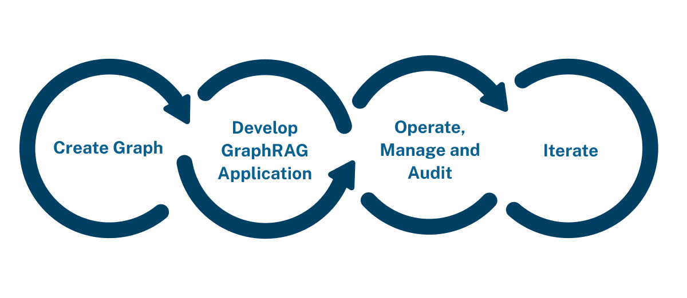
GraphRAG Lifecycle
A GenAI application that uses GraphRAG follows the same pattern as any RAG application, with an added “create graph” step at the start:

Slide 15
GraphRAG Lifecycle - Graph is analogous
Creating a graph is analogous to chunking documents and loading them into a vector database. Advances in tooling have made graph creation literally that easy. The good news is threefold:
Graphs are highly iterative – you can start with a “minimum viable graph” and expand from there.
Once your data is in a knowledge graph, it becomes very easy to evolve. You can add more kinds of data, to reap the benefits of data network effects. You can also improve the quality of the data to up the value of your application results.
This part of the stack is rapidly improving, which means graph creation will only get easier as tooling gets more sophisticated.

Slide 16
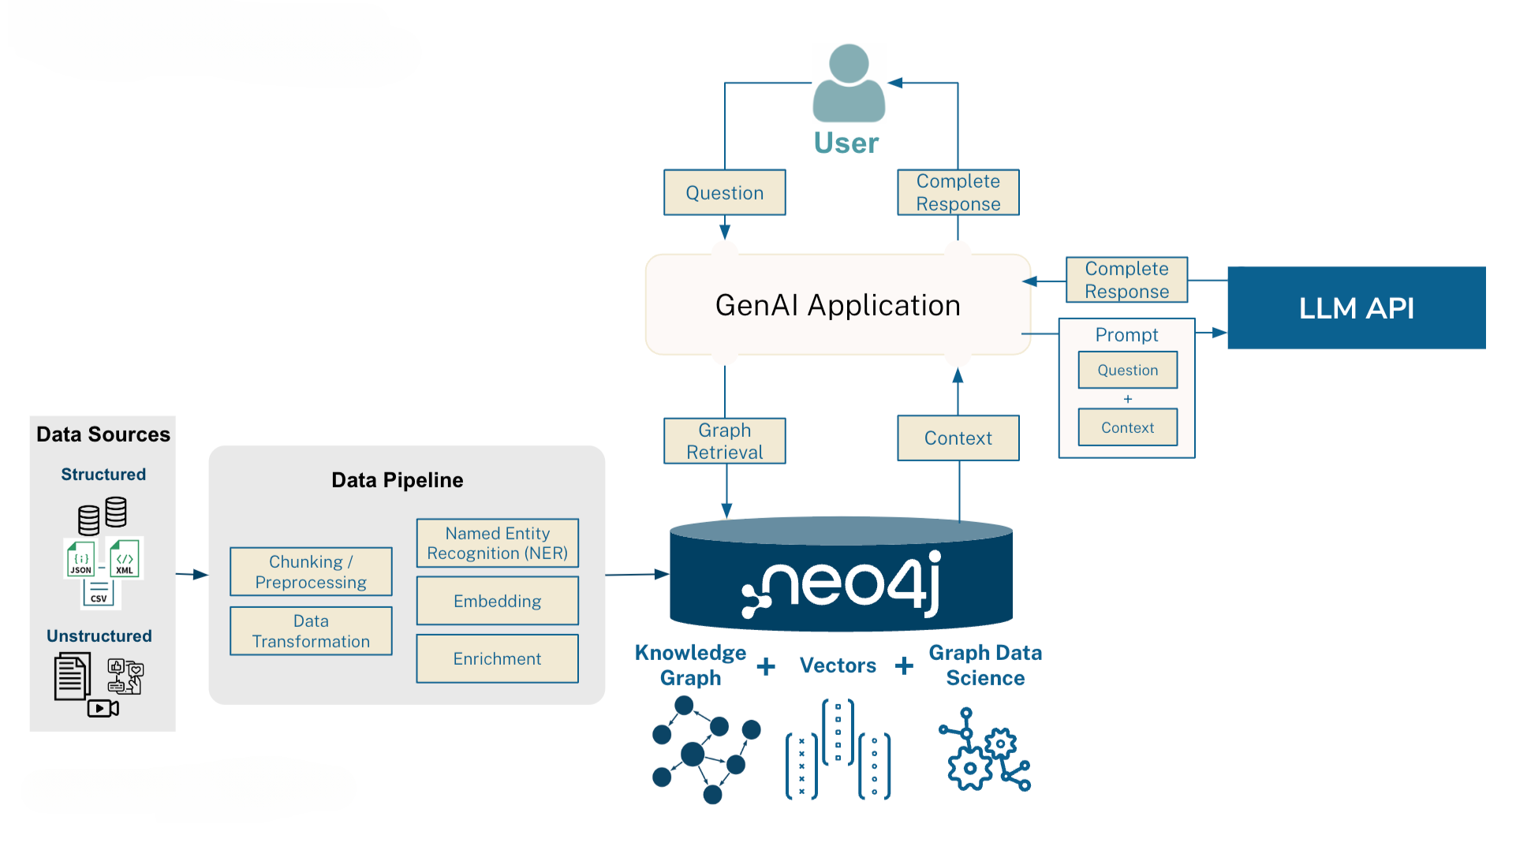
Understanding GraphRAG using Architect
Source

Slide 17
GraphRAG generally offers better accuracy than simple for several key reasons:
Understanding Relationships: Simple RAG typically retrieves information based on semantic similarity between the query and chunks of text. It often misses the crucial relationships between different pieces of information that might be spread across multiple documents. GraphRAG, by leveraging a knowledge graph, explicitly models these relationships as edges between entities (nodes). This allows it to retrieve information by understanding how different concepts are connected, leading to more contextually relevant results, especially for complex or multi-hop queries.
Structured Knowledge Representation: Knowledge graphs organize information in a structured format (entities and relationships), making it easier to navigate and reason over the data compared to unstructured text chunks in simple RAG. This structured representation helps in precise information retrieval and reduces the chances of irrelevant information being included in the context provided to the Language Model (LLM).
Enhanced Contextual Awareness: By traversing the graph, GraphRAG can gather a more comprehensive and interconnected context for the LLM. It can retrieve not just the directly relevant nodes but also their neighbors and the relationships connecting them. This richer context enables the LLM to generate more accurate and insightful answers, especially for questions requiring reasoning or synthesis of information from various parts of the knowledge base.
Improved Handling of Multi-Hop Queries: Simple RAG often struggles with questions that require connecting information from multiple different text segments (multi-hop queries). GraphRAG excels in these scenarios because it can traverse the graph through multiple relationships to find the answer, effectively "hopping" between related entities to synthesize the required information.
Reduced Hallucinations: By grounding the information retrieval in a structured and factual knowledge graph, GraphRAG can potentially reduce the LLM's tendency to generate incorrect or hallucinated information. The explicit relationships in the graph provide a stronger anchor for the retrieved context compared to relying solely on semantic similarity of text chunks.Better
Explainability and Traceability: The structured nature of a knowledge graph allows for better explainability of the retrieval process. The paths and connections within the graph that led to the retrieved information can be traced, making it easier to understand why certain information was provided.

Slide 18
What is Neo4j?
Neo4j is Graph based Database Technology.
Neo4j’s primary product and focus is our graph database that stores data in the form of nodes and relationships.
It handles both transactional and/or analytics workloads and is optimized for traversing paths through the data using the relationships in the graph to find connections between entities..
Data Traversal makes Neo4j fast.

Slide 19
Business benefits of using Neo4j
Accelerated Insights and Discovery
Benefit: Better decisions driven by a holistic understanding of connected data. Why Neo4j: By modeling how different data points relate to each other (e.g., a customer's interactions, purchases, location, and associated support tickets), you get a comprehensive view. Business Outcome: Enables more informed decisions in areas like risk assessment, strategic planning, resource allocation, and understanding customer behavior in context.
Enhanced Performance for Connected Data
Benefit: Real-time or near-real-time performance for queries involving many relationships. Why Neo4j: Graph traversals in Neo4j perform at constant time relative to the size of the subgraph being traversed, rather than the overall size of the database (unlike JOINs which can degrade significantly as data grows). Business Outcome: Powers applications requiring rapid traversal, such as real-time recommendation engines, immediate fraud detection, dynamic network analysis, and responsive customer 360 views.
Improved Decision-Making & Intuitive Data Modeling and Collaboration
Benefit: Easier for diverse teams (including non-database experts) to understand and work with the data model.
Why Neo4j: The whiteboard-friendly node and relationship model is visually intuitive. The Cypher query language is designed to be easily readable and understandable.
Business Outcome: Fosters better collaboration between developers, data scientists, and domain experts, reduces misinterpretations of the data, and speeds up the development and iteration process.

Slide 20
Business benefits of using Neo4j
Increased Agility and Flexibility
Benefit: Easier adaptation to evolving data models and integration of new data sources.
Reduced Risk and Improved Security
Benefit: More effective identification of complex fraud patterns, security vulnerabilities, and compliance risks.
Better Customer Experience
Benefit: More personalized recommendations, improved customer service, and a deeper understanding of customer journeys.
Why Neo4j: Graph databases have a flexible, schema-on-read nature. You can add new node labels, relationship types, or properties without needing costly and time-consuming database migrations that are often required in relational databases.
Business Outcome: Reduces time-to-market for new features, products, and data-driven initiatives. Allows companies to quickly incorporate new types of data and explore relationships as they discover them.
Why Neo4j: Fraud and security threats often manifest as unusual or complex relationship patterns that are easily modeled and queried in a graph (e.g., multiple accounts linked to the same device or address, unusual login patterns across a network).
Business Outcome: Proactive detection of sophisticated fraud, better management of access controls and dependencies in IT networks, and improved ability to demonstrate compliance through traceable data lineage.
Why Neo4j: Connects customer data points across various touchpoints, preferences, and behaviors to build a rich customer profile and understand their path.
Business Outcome: Leads to more relevant product or service recommendations, faster resolution of support issues by seeing the full context, and the ability to tailor interactions based on the customer's history and relationships.

Slide 21
Alternative GraphRAG Approaches
Alternative GraphRAG Approaches with Neo4j & LlamaIndex: Combines graph databases and retrieval-augmented generation using Neo4j and LlamaIndex to enhance contextual reasoning in LLMs.
LangChain Framework: A modular framework for building LLM-powered applications with components like chains, agents, and memory for dynamic workflows.
LLMGraphTransformer: Transforms unstructured data into structured graph representations to enable reasoning and querying with large language models.
ETL with Neo4j and Agentic AI: Uses AI agents to automate Extract-Transform-Load pipelines into Neo4j, enabling intelligent data ingestion and graph construction.

Slide 22
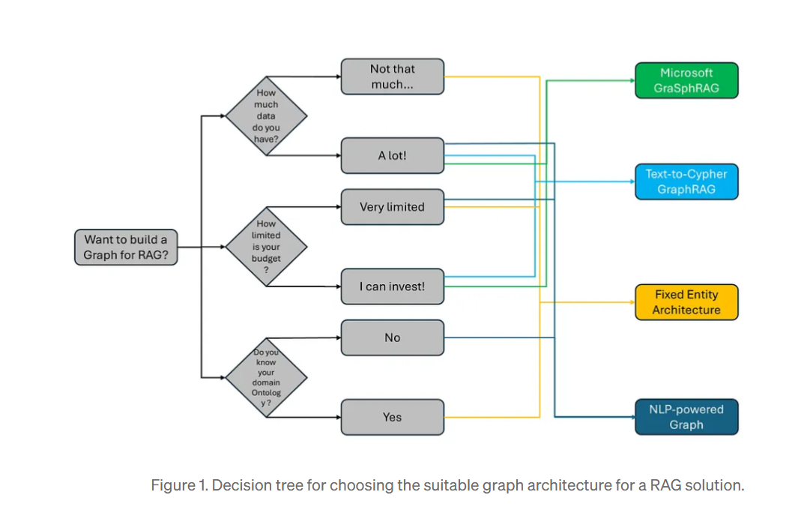

Slide 23
Constructing knowledge graphs
The basic ways of constructing a knowledge graph based on unstructured text. The constructured graph can then be used as knowledge base in a RAG application.
#Architecture
At a high-level, the steps of constructing a knowledge are from text are:
Extracting structured information from text: Model is used to extract structured graph information from text.
Storing into graph database: Storing the extracted structured graph information into a graph database enables downstream RAG applications
#Setup
First, get required packages and set environment variables. In this example, we will be using Neo4j graph database.
%pip install --upgrade --quiet langchain langchain-community langchain-openai langchain-experimental neo4j
Source

Slide 24
OpenAI models and Neo4j credentials and connection
import getpass
import os
os.environ["OPENAI_API_KEY"] = getpass.getpass()
# Uncomment the below to use LangSmith. Not required.
# os.environ["LANGCHAIN_API_KEY"] = getpass.getpass()
# os.environ["LANGCHAIN_TRACING_V2"] = "true“
import os
from langchain_community.graphs import Neo4jGraph
os.environ["NEO4J_URI"] = "bolt://localhost:7687"
os.environ["NEO4J_USERNAME"] = "neo4j"
os.environ["NEO4J_PASSWORD"] = "password"
graph = Neo4jGraph()
Source

Slide 25
LLM Graph Transformer
Extracting graph data from text enables the transformation of unstructured information into structured formats, facilitating deeper insights and more efficient navigation through complex relationships and patterns.
The LLMGraphTransformer converts text documents into structured graph documents by leveraging a LLM to parse and categorize entities and their relationships.
The selection of the LLM model significantly influences the output by determining the accuracy and nuance of the extracted graph data.
Source

Slide 26
import os
from langchain_experimental.graph_transformers import LLMGraphTransformer
from langchain_openai import ChatOpenAI
llm = ChatOpenAI(temperature=0, model_name="gpt-4-turbo")
llm_transformer = LLMGraphTransformer(llm=llm)
Source

Slide 27
Now we can pass in example text and examine the results.
from langchain_core.documents import Document
text = """
Marie Curie, born in 1867, was a Polish and naturalised-French physicist and chemist who conducted pioneering research on radioactivity.
She was the first woman to win a Nobel Prize, the first person to win a Nobel Prize twice, and the only person to win a Nobel Prize in two scientific fields.
Her husband, Pierre Curie, was a co-winner of her first Nobel Prize, making them the first-ever married couple to win the Nobel Prize and launching the Curie family legacy of five Nobel Prizes.
She was, in 1906, the first woman to become a professor at the University of Paris.
"""
documents = [Document(page_content=text)]
graph_documents = llm_transformer.convert_to_graph_documents(documents)
print(f"Nodes:{graph_documents[0].nodes}")
print(f"Relationships:{graph_documents[0].relationships}")
Source

Slide 28
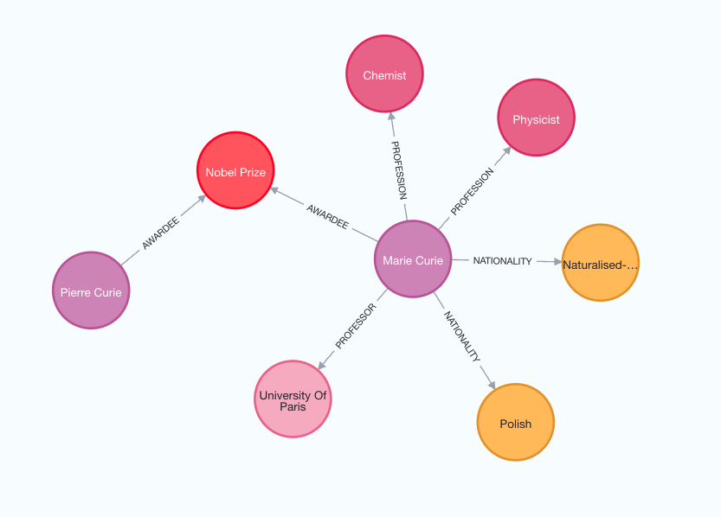
Representation of node and relationship in neo4j instance
Nodes:[Node(id='Marie Curie', type='Person'), Node(id='Pierre Curie', type='Person'), Node(id='University Of Paris', type='Organization’)]
Relationships:[Relationship(source=Node(id='Marie Curie', type='Person'), target=Node(id='Pierre Curie', type='Person'), type='MARRIED'), Relationship(source=Node(id='Marie Curie', type='Person'), target=Node(id='University Of Paris', type='Organization'), type='PROFESSOR')]

Slide 29
Additionally, you have the flexibility to define specific types of nodes and relationships for extraction according to your requirements.
llm_transformer_filtered = LLMGraphTransformer(
llm=llm,
allowed_nodes=["Person", "Country", "Organization"],
allowed_relationships=["NATIONALITY", "LOCATED_IN", "WORKED_AT", "SPOUSE"],
)
graph_documents_filtered = llm_transformer_filtered.convert_to_graph_documents(
documents
)
print(f"Nodes:{graph_documents_filtered[0].nodes}")
print(f"Relationships:{graph_documents_filtered[0].relationships}")
Output:
Nodes:[Node(id='Marie Curie', type='Person'), Node(id='Pierre Curie', type='Person'), Node(id='University Of Paris', type='Organization')]
Relationships:[Relationship(source=Node(id='Marie Curie', type='Person'), target=Node(id='Pierre Curie', type='Person'), type='SPOUSE'), Relationship(source=Node(id='Marie Curie', type='Person'), target=Node(id='University Of Paris', type='Organization'), type='WORKED_AT')]

Slide 30
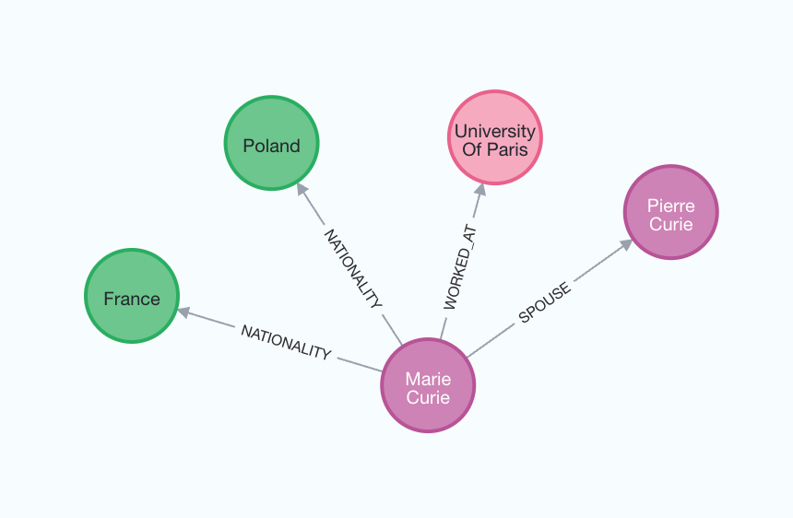
For a better understanding of the generated graph, we can again visualize it.

Slide 31
References
https://microsoft.github.io/graphrag/
https://neo4j.com/blog/graphrag-manifesto/#n6
https://blog.google/products/search/introducing-knowledge-graph-things-not/
https://python.langchain.com/v0.1/docs/use_cases/graph/constructing/
https://medium.com/data-science-in-your-pocket/rag-framework-explained-and-faqs-d956ea0a6d16
https://docs.llamaindex.ai/en/stable/examples/query_engine/knowledge_graph_rag_query_engine/
https://www.youtube.com/watch?v=wXTs3cmZuJA
https://datasciencepocket.gumroad.com/l/cxrgr?layout=profile

